Slide 1
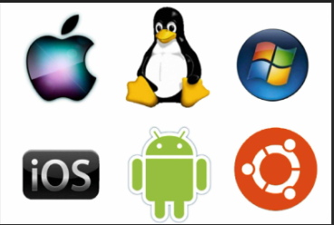
Operating System UNIT 1
Introduction to Operating System
By:
Amandeep Kaur

Slide 2
Topics
Introduction to OS
Supervisor and User Mode
OS Structure
Functions of OS
System Calls
Evolution & Types of OS

Slide 3
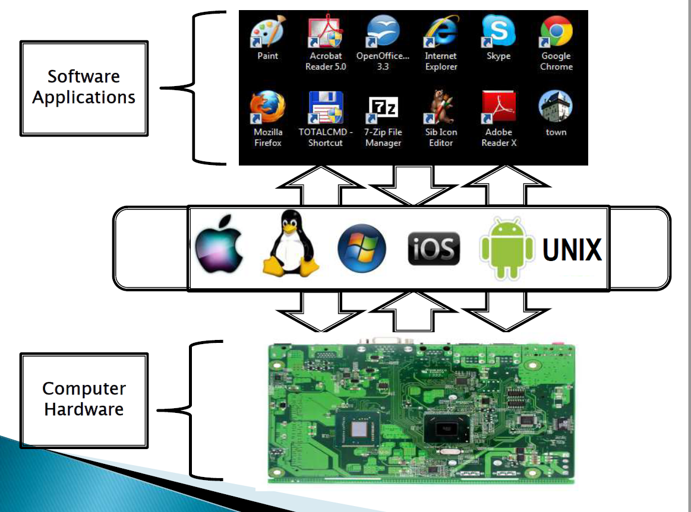
OS (Operating System) ?

Slide 4
OS?
It is System Software &
It works as an interface between user and hardware.
For Example: Window (all versions), Linux ( Kali, CentOS, RedHat etc.)

Slide 5
Is it possible to work on system without OS?
Yes
No

Slide 6
Q. What is an Operating System?
a) interface between the hardware and application programs b) collection of programs that manages hardware resources c) system service provider to the application programs d) all of the mentioned

Slide 7
Ans. d
d) all of the mentioned
Because An Operating System acts as an intermediary between user/user applications/application programs and hardware. It is a program that manages hardware resources. It provides services to application programs.

Slide 8
Why OS?
Convenience to the user (due to System Calls i.e. Open, Close, Read, Write etc.)
Throughput (Linux) i.e. No. of tasks executed per unit time.

Slide 9
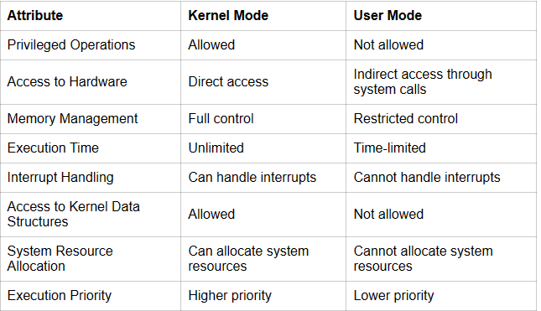
Supervisor (Kernel) Mode (#) VS User Mode ($)

Slide 10
Q. What of the following is not the type of OS?
a. Windows
b. RHEL
c. Oracle
d. Android

Slide 11
Ans. C
c. Oracle

Slide 12
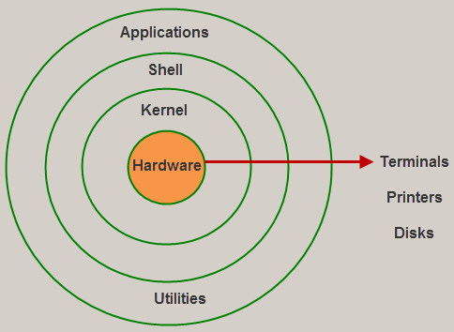
OS Structure

Slide 13
OS Structure
Hardware is the storage space like hard disk, floppy disk, CD drive etc.
Kernel is the heart of the OS where we can find many system call.
System call i.e. which consist of codes for commands.
It handles many functions like managing files, creating file directories, managing memory etc.

Slide 14
OS Structure
Shell is interface between kernel and application.
i.e. It is a place where we write program and execute them.
Syntaxes are checked and errors are rectified in this shell.
Application are nothing but are things which we see or we use, are applications.

Slide 15
Q.In the layered structure of an operating system, which layer is responsible for handling hardware-level operations, such as CPU scheduling and device management?
A. Application Layer B. Shell Layer C. Hardware Layer D. User Interface Layer

Slide 16
Ans. C
C. Hardware Layer

Slide 17
Q. What is the main function of the CLI (Command Line interpreter) or Shell?
To provide the interface between the API and application program
To handle the files in the OS
To get and execute the next user-specified command
None of the mentioned

Slide 18
Ans. C
The main function of a command interpreter is to get and execute the next user-specified command. Command Interpreter checks for valid command and then runs that command else it will throw an error.

Slide 19
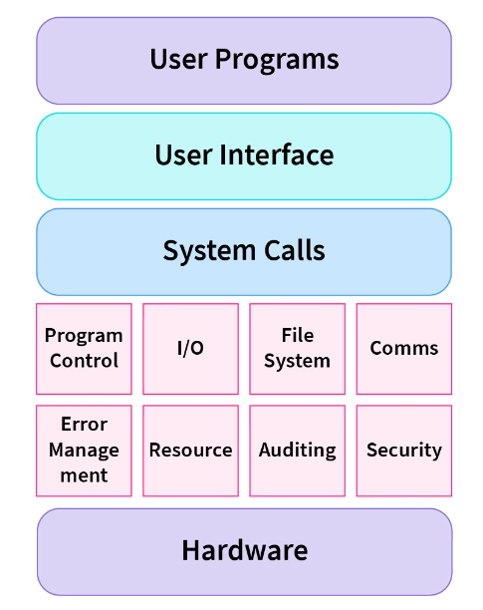
Q. What is System Call?

Slide 20
System Calls
System call i.e. which consist of codes for commands using C language or predefined functions that OS directly invoke or It is a way for a user program to interface with the OS.
The program requests several services, and the OS responds by invoking a series of system calls to satisfy the request. The kernel system can only be accessed using system calls. System calls are required for any programs that use resources.

Slide 21
Example
Open a file or open folder (directory).
In case of system, read() and write()
K/B for read data : read()
Monitor for Write data : write()

Slide 22
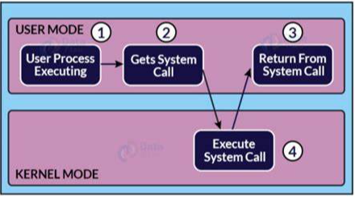
How System Calls Works?
Step 1) The processes executed in the user mode till the time a system call interrupts it.
Step 2) After that, the system call is executed in the kernel-mode on a priority basis.
Step 3) Once system call execution is over, control returns to the user mode.,
Step 4) The execution of user processes resumed in Kernel Mode.

Slide 23
Why System Calls?
Reading and writing from files demand system calls.
If a file system wants to create or delete files, system calls are required.
System calls are used for the creation and management of new processes.
Network connections need system calls for sending and receiving packets.
Access to hardware devices like scanner, printer, need a system call.

Slide 24
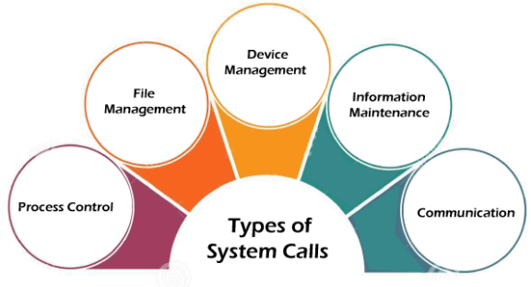
Types of System Calls

Slide 25
Types of System Calls
Process Control
Process control is the system call that is used to direct the processes. It include creating, load, abort, end, execute, terminate the process, etc.
File Management
File management is a system call that is used to handle the files. It include creating files, delete files, open, close, read, write, etc.
Device Management
Device management is a system call that is used to deal with devices. It include read device, write device, get device attributes, release device, etc.

Slide 26
Types of System Calls
Information Maintenance
It is used to maintain information. For example: getting system data, set time or date, get time or date, set system data, etc.
Communication
It is used for communication. For example: create, delete communication connections, send, receive messages, etc.

Slide 27
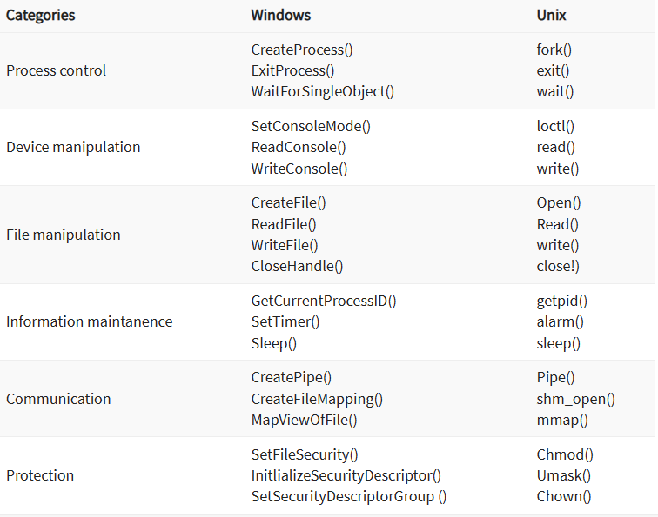
Some Important System calls in Windows and Unix OS

Slide 28
Few methods in brief
open()
The open() system call allows you to access a file on a file system. It allocates resources to the file and provides a handle that the process may refer to. Many processes can open a file at once or by a single process only. It's all based on the file system and structure.
close()
It is used to end file system access. When this system call is invoked, it signifies that the program no longer requires the file, and the buffers are flushed, the file information is altered, and the file resources are de-allocated as a result.

Slide 29
Few methods in brief
read(): It is used to obtain data from a file on the file system. It accepts three arguments in general:
A file descriptor.
A buffer to store read data.
The number of bytes to read from the file.
The file descriptor of the file to be read could be used to identify it and open it using open() before reading.

Slide 30
Few methods in brief
write()
It is used to write data from a user buffer to a device like a file. This system call is one way for a program to generate data. It takes three arguments in general:
A file descriptor.
A pointer to the buffer in which data is saved.
The number of bytes to be written from the buffer.

Slide 31
Few methods in brief
fork()
It is one of the most common ways to create processes in operating systems. Also, clone (copy) of that process.
Formulas to find:
Total no. of Process = 2n
Total No. of Child Process = 2^{n} - 1

Slide 32
Few methods in brief
Wait()
In some systems, a process may have to wait for another process to complete its execution before proceeding. When a parent process makes a child process, the parent process execution is suspended until the child process is finished. The wait() system call is used to suspend the parent process. Once the child process has completed its execution, control is returned to the parent process.

Slide 33
Few methods in brief
exec(): When an executable file replaces an earlier executable file in an already executing process, this system function is invoked. As a new process is not built, the old process identification stays, but the new process replaces data, stack, data, head, etc.
exit():It is used to end program execution. This call indicates that the thread execution is complete, which is especially useful in multi-threaded environments. The OS reclaims resources spent by the process following the use of the exit() system function.

Slide 34
Q. Which of the following is NOT a type of system call in an operating system?
A) Process control B) File management C) Memory allocation D) User interface rendering

Slide 35
Ans.D
D) User interface rendering
User interface rendering is typically handled by higher-level libraries or frameworks, not by system calls. System calls are used for low-level operations like process control, file management, and memory management.

Slide 36
Q. Which system call is used to create process?
Open()
Write()
Fork()
Sleep()

Slide 37
Ans. c
Fork(): it is used to create new process and there is formula to find out the number of child process which is 2^{n}-1

Slide 38
Main Functions of OS
Resource Management (H/W)
Process Management (CPU Scheduling)
Storage Management (HD)
Memory Management (RAM)
Security (Password)

Slide 39
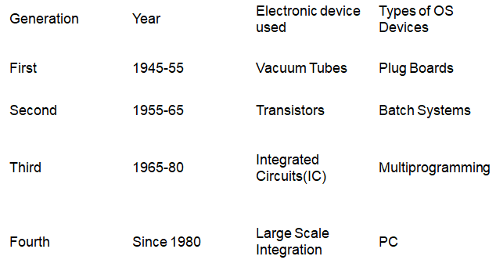
Evolution of OS

Slide 40
Types of OS
Simple Batch System
Multi-Programming & Multi-Processing System
Multi-Tasking
Parallel
Distributed &
Real-Time Operating System (RTOS) etc.

Slide 41
Batch System
It does not interact with the computer directly. There is an operator which takes similar jobs having the same requirement and groups them into batches. It is the responsibility of the operator to sort jobs with similar needs.
In this system, Punch cards/Paper Cards/Magnetic Tape used
Problem: idleness(CPU)
Solution: Multi-Programming concept

Slide 42
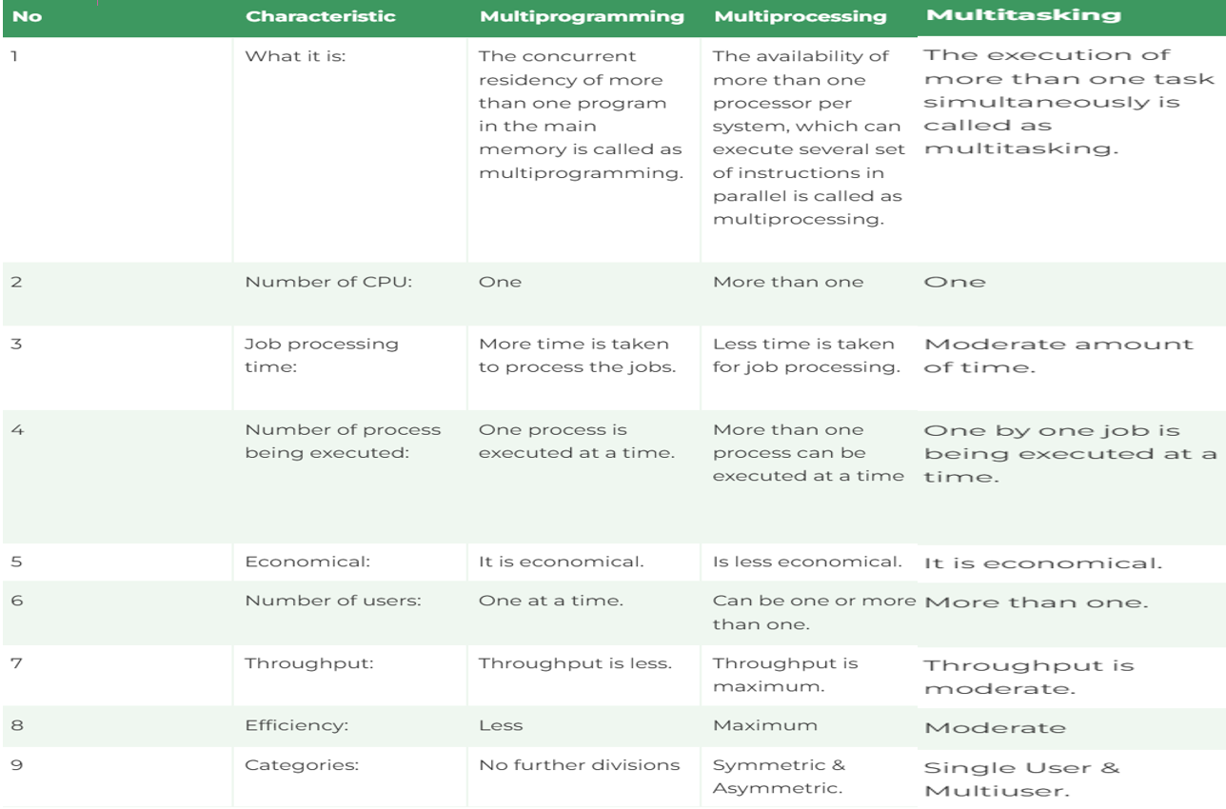
Multi-Programming,Multi-Processing & Multi-Tasking

Slide 43
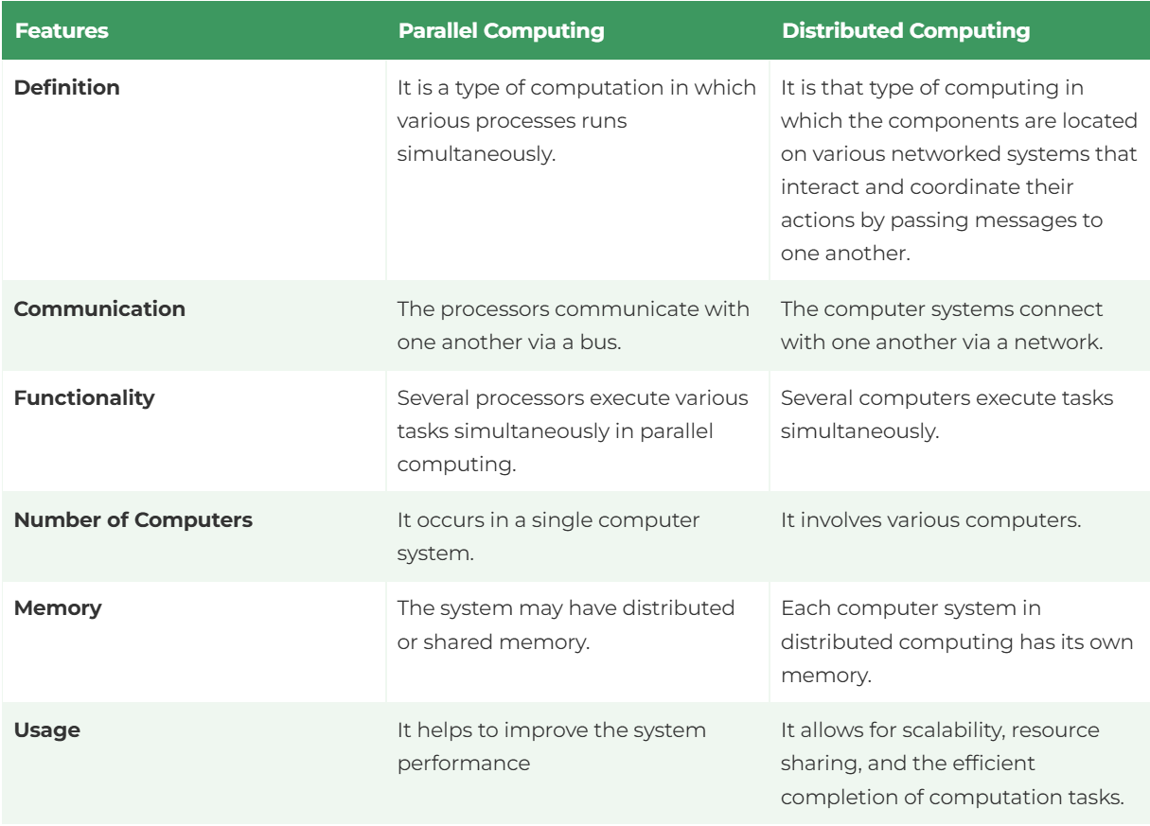
Parallel V/S Distributed System

Slide 44
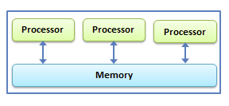
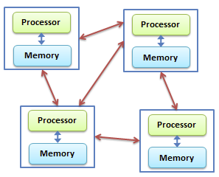
Parallel V/S Distributed System
Parallel System
Distributed System

Slide 45
Real-Time OS
In RTOS, the time interval required to process and respond to inputs is very small. This time interval is called response time. Real-time systems are used when there are time requirements.
Types of Real-Time Operating Systems
Hard Real-Time Systems: These OSs are for applications where time-constraint is stricter than soft real time systems. For eg. Missile, Rocket etc.
Soft Real-Time Systems: These OSs are for applications where time-constraint is less strict. For eg. Microwave, Washing Machine etc.

Slide 46
Network/Clustered OS
For Eg. Shared media, In Cafe, all computer share same printer.
Availability (high)
Fault Tolerance (due to load balance)
Load Balance
Scalability (improve computational speed. For eg. X speed converted into 2X in future by adding multiple clusters)
It works like server
Computational Power (high)
For eg. Super-Computer,LAN system etc.

Slide 47
Embedded OS
Fixed Funcationality
For eg. Microwave, Machine, AC etc
No change (There is no change in motherboard)

Slide 48
References
OPERATING SYSTEM CONCEPTS by ABRAHAM SILBERSCHATZ, PETER B. GALVIN, GERG GAGNE, WILEY
DESIGN OF THE UNIX OPERATING SYSTEM by MAURICE J. BACH, Pearson Education India
REAL-TIME SYSTEMS by JANE W. S. LIU, Pearson Education India
https://www.javatpoint.com/history-of-operating-system
https://www.javatpoint.com/multiprogramming-vs-multiprocessing-vs-multitasking-vs-multithreading
https://www.youtube.com/watch?v=xIS6JURQ9rE
https://www.javatpoint.com/system-calls-in-operating-system#:~:text=A%20system%20call%20is%20a,language%20like%20C%20or%20Pascal.

Slide 49

Thank You

